Slide 1

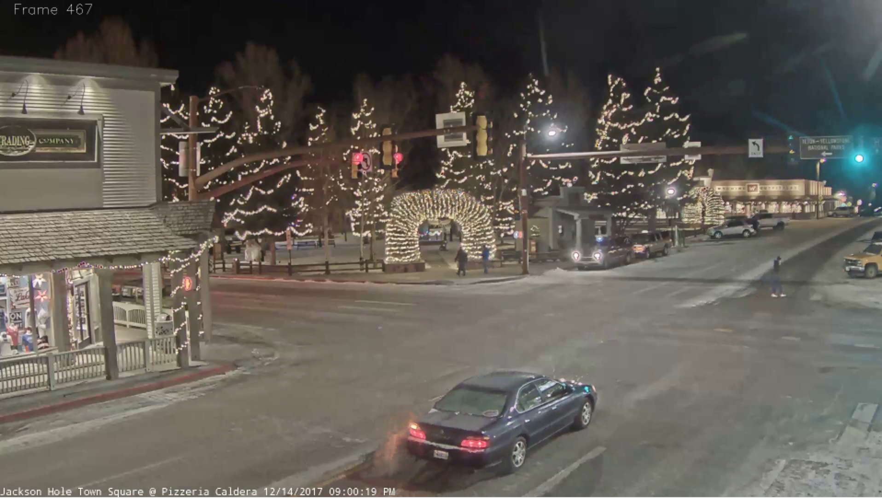
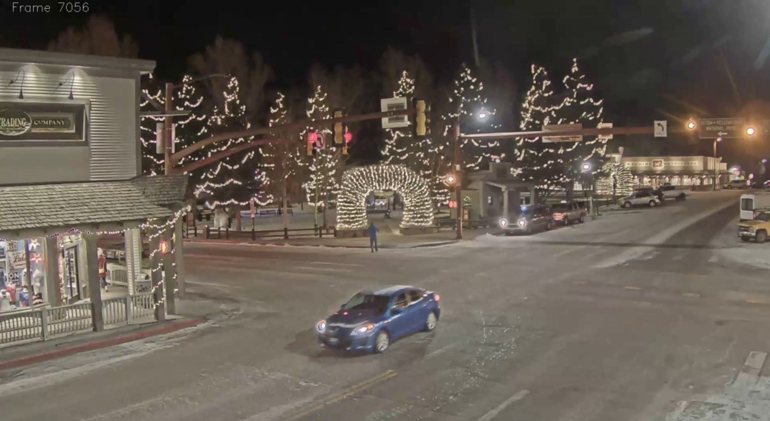
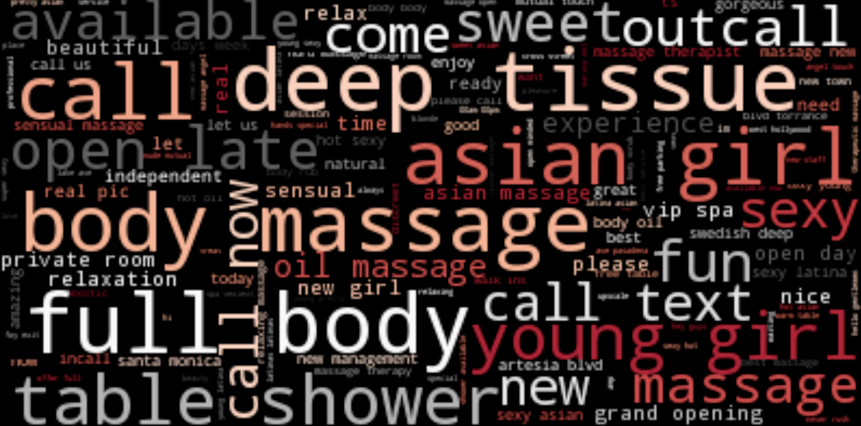
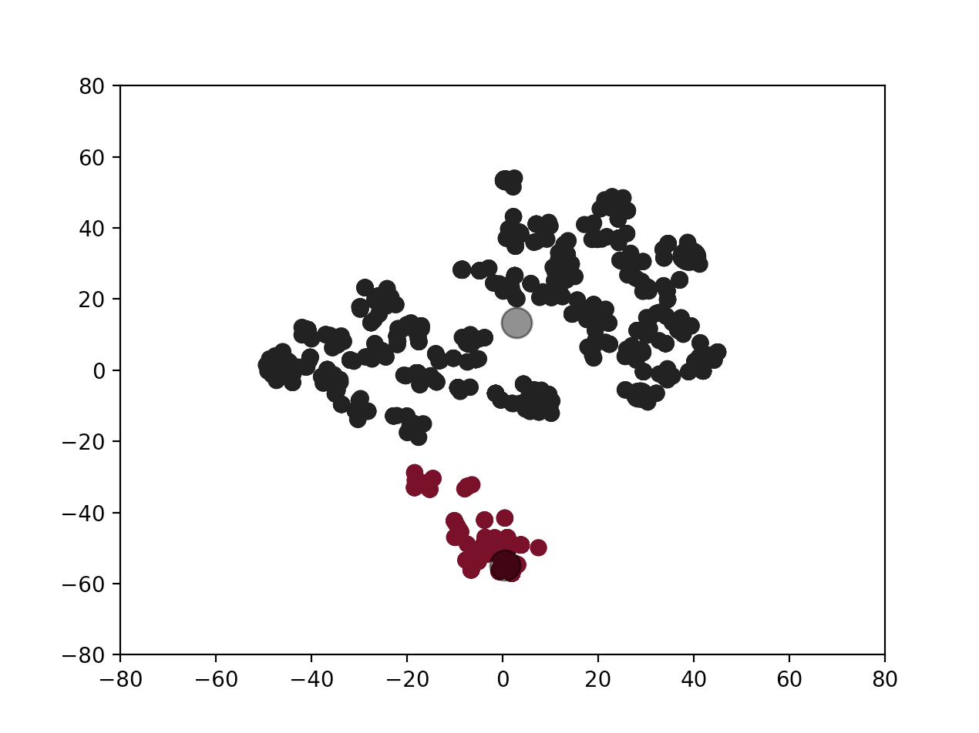
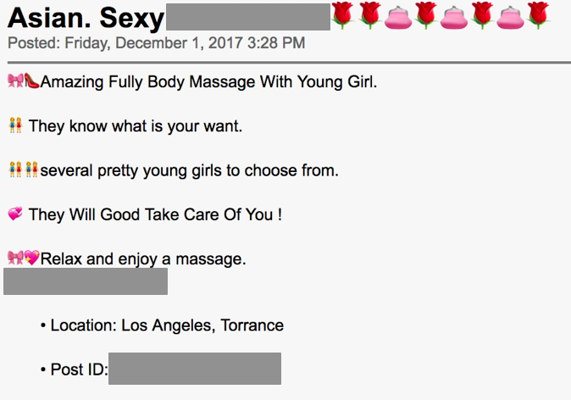
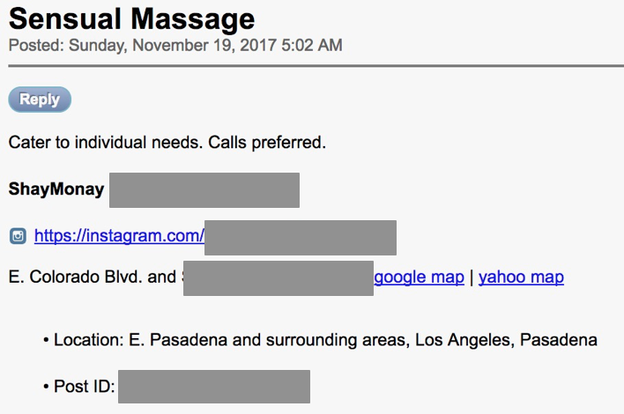
Automated Visual Weak Supervision for Object Recognition in Videos
Swetha Revanur and Vishnu Sarukkai
(srevanur, sarukkai) @ stanford.edu
Abstract #
20980123
Motivation
Pipeline
Phase III: CNN-Based Binary Classifier
As cameras become an increasingly ubiquitous part of modern life, videos offer a valuable source of data for a variety of applications. However, it is intractable for humans to manually observe most of this incoming content.
1
2
E. Deep Ladder Networks cont’d.
Convolutional
Autoencoder
Tube Production
It is crucial to be able to semantically parse the video, starting with entity classification.
Phase I: Image Encoding
A. Feature Engineering
Represent each post as a 19-dimensional binary feature vector:
B. Unsupervised Filtering
We obtain 1857 records from our dataset by filtering out samples that don’t possess any of the binary features. This is our filtered dataset.
3
4
Visual Weak Supervision
CNN Classifier
Feature Group | Features
Language Pattern | third-person voice, first-person plural pronouns, Shannon entropy to assess text complexity, n-grams with TF-IDF (n = 3)
Keywords | [young, fresh, new, new in town, new arrival, open minded, petite, exotic, youthful, barely legal, virgin, tiny, incall, in call, new to the game, candy == 1]
Countries of Interest | [china, vietnam, korea, thailand, asian == 1]
Multiple Victims | [girls, women, men, boys, people, children, babes, dolls, masseuses == 1]
Victim Weight | [victim weight ≤110]
Spa Reference | [spa, massage == 1]
Presence of Emojis | [🌹, 🍒, 🌸, 💗, ✈️, 👑 == 1]
To verify the fidelity of our filtering we apply the t-SNE transformation to create 2D projections of the filtered and junk feature vectors. We cluster these projections using K-means (K = 2).
Weak Supervision
Use a variety of heuristics and a small number of labeled data points to predict labels for a large number of unlabeled points. These weakly-labeled points can then be added to a training set for a future classifier.
Trading certainty in the labels for a larger training set.
Results
filtered
We report the preliminary accuracies of the the various approaches when trained on a subset of the filtered dataset:
We observe that our TensorFlow implementation of Deep Ladder Networks achieves the highest accuracy. On the left, is a Backpage post correctly classified as human trafficking. On the right is a post correctly classified as a consensual activity.
junk
Approach | Precision | Recall | Accuracy
Baseline Majority Algorithm | --- | --- | 56.667%
Oracle | 100% | 100% | 100%
Label Spreading (RBF) | 64% | 64% | 63%
Label Spreading (KNN) | 70% | 68% | 67%
Deep Ladder Networks | --- | --- | 80%
Objectives
Creating an automated pipeline for automating the generation of heuristics for visual weak supervision.
Exploring the trade-off between the number of weakly- labeled data points used in training a subsequent classification model for videos.
Phase II: Automated Visual Weak Supervision with Reef
A. Expert Labeling
Since we lack ground truth for our data, we rely on manual labels provided by experts.
Of the 1857 records, 300 were labeled.
Semi-Supervised Classification Task Definition
We have now reduced our task to a semi-supervised binary classification problem (semi-supervised due to the presence of both labeled and unlabeled data).
Pipeline
B. Baseline and Oracle
The baseline is a majority algorithm for post classification. The majority algorithm classifies all the examples in the testing set as the majority class of the training set.
The oracle is manual labeling of the entire filtered dataset.
C. Feature Extraction with Topic Modeling
Using Latent Dirichlet Allocation (LDA) topic modeling, we extract 7 of the most representative topics in the filtered dataset. LDA hyperparameters were tuned by evaluating the metrics proposed by Griffiths, Cao/Juan, and Arun.
D. Label Spreading
Label spreading is a semi-supervised graph inference algorithm. Each unlabeled node i
Selected References
Alvari et al., A Non-Parametric Learning Approach to Identify Online Human Trafficking
Rasmus et al., Semi-Supervised Learning with Ladder Networks

